Slide 1
Heuchera microbiome project
Folk lab

Slide 2
Intro
Plant-microbe associations – the dark matter of plant communities
Few large surveys
Most: One agricultural species, or survey of one field site
Either anthropogenic systems or wide phylogenetic scales
Hoping to add perspective at a narrow phylogenetic scale in a natural system
Simultaneously incorporate population to phylogenetic scales – densely sample one plant genus

Slide 3
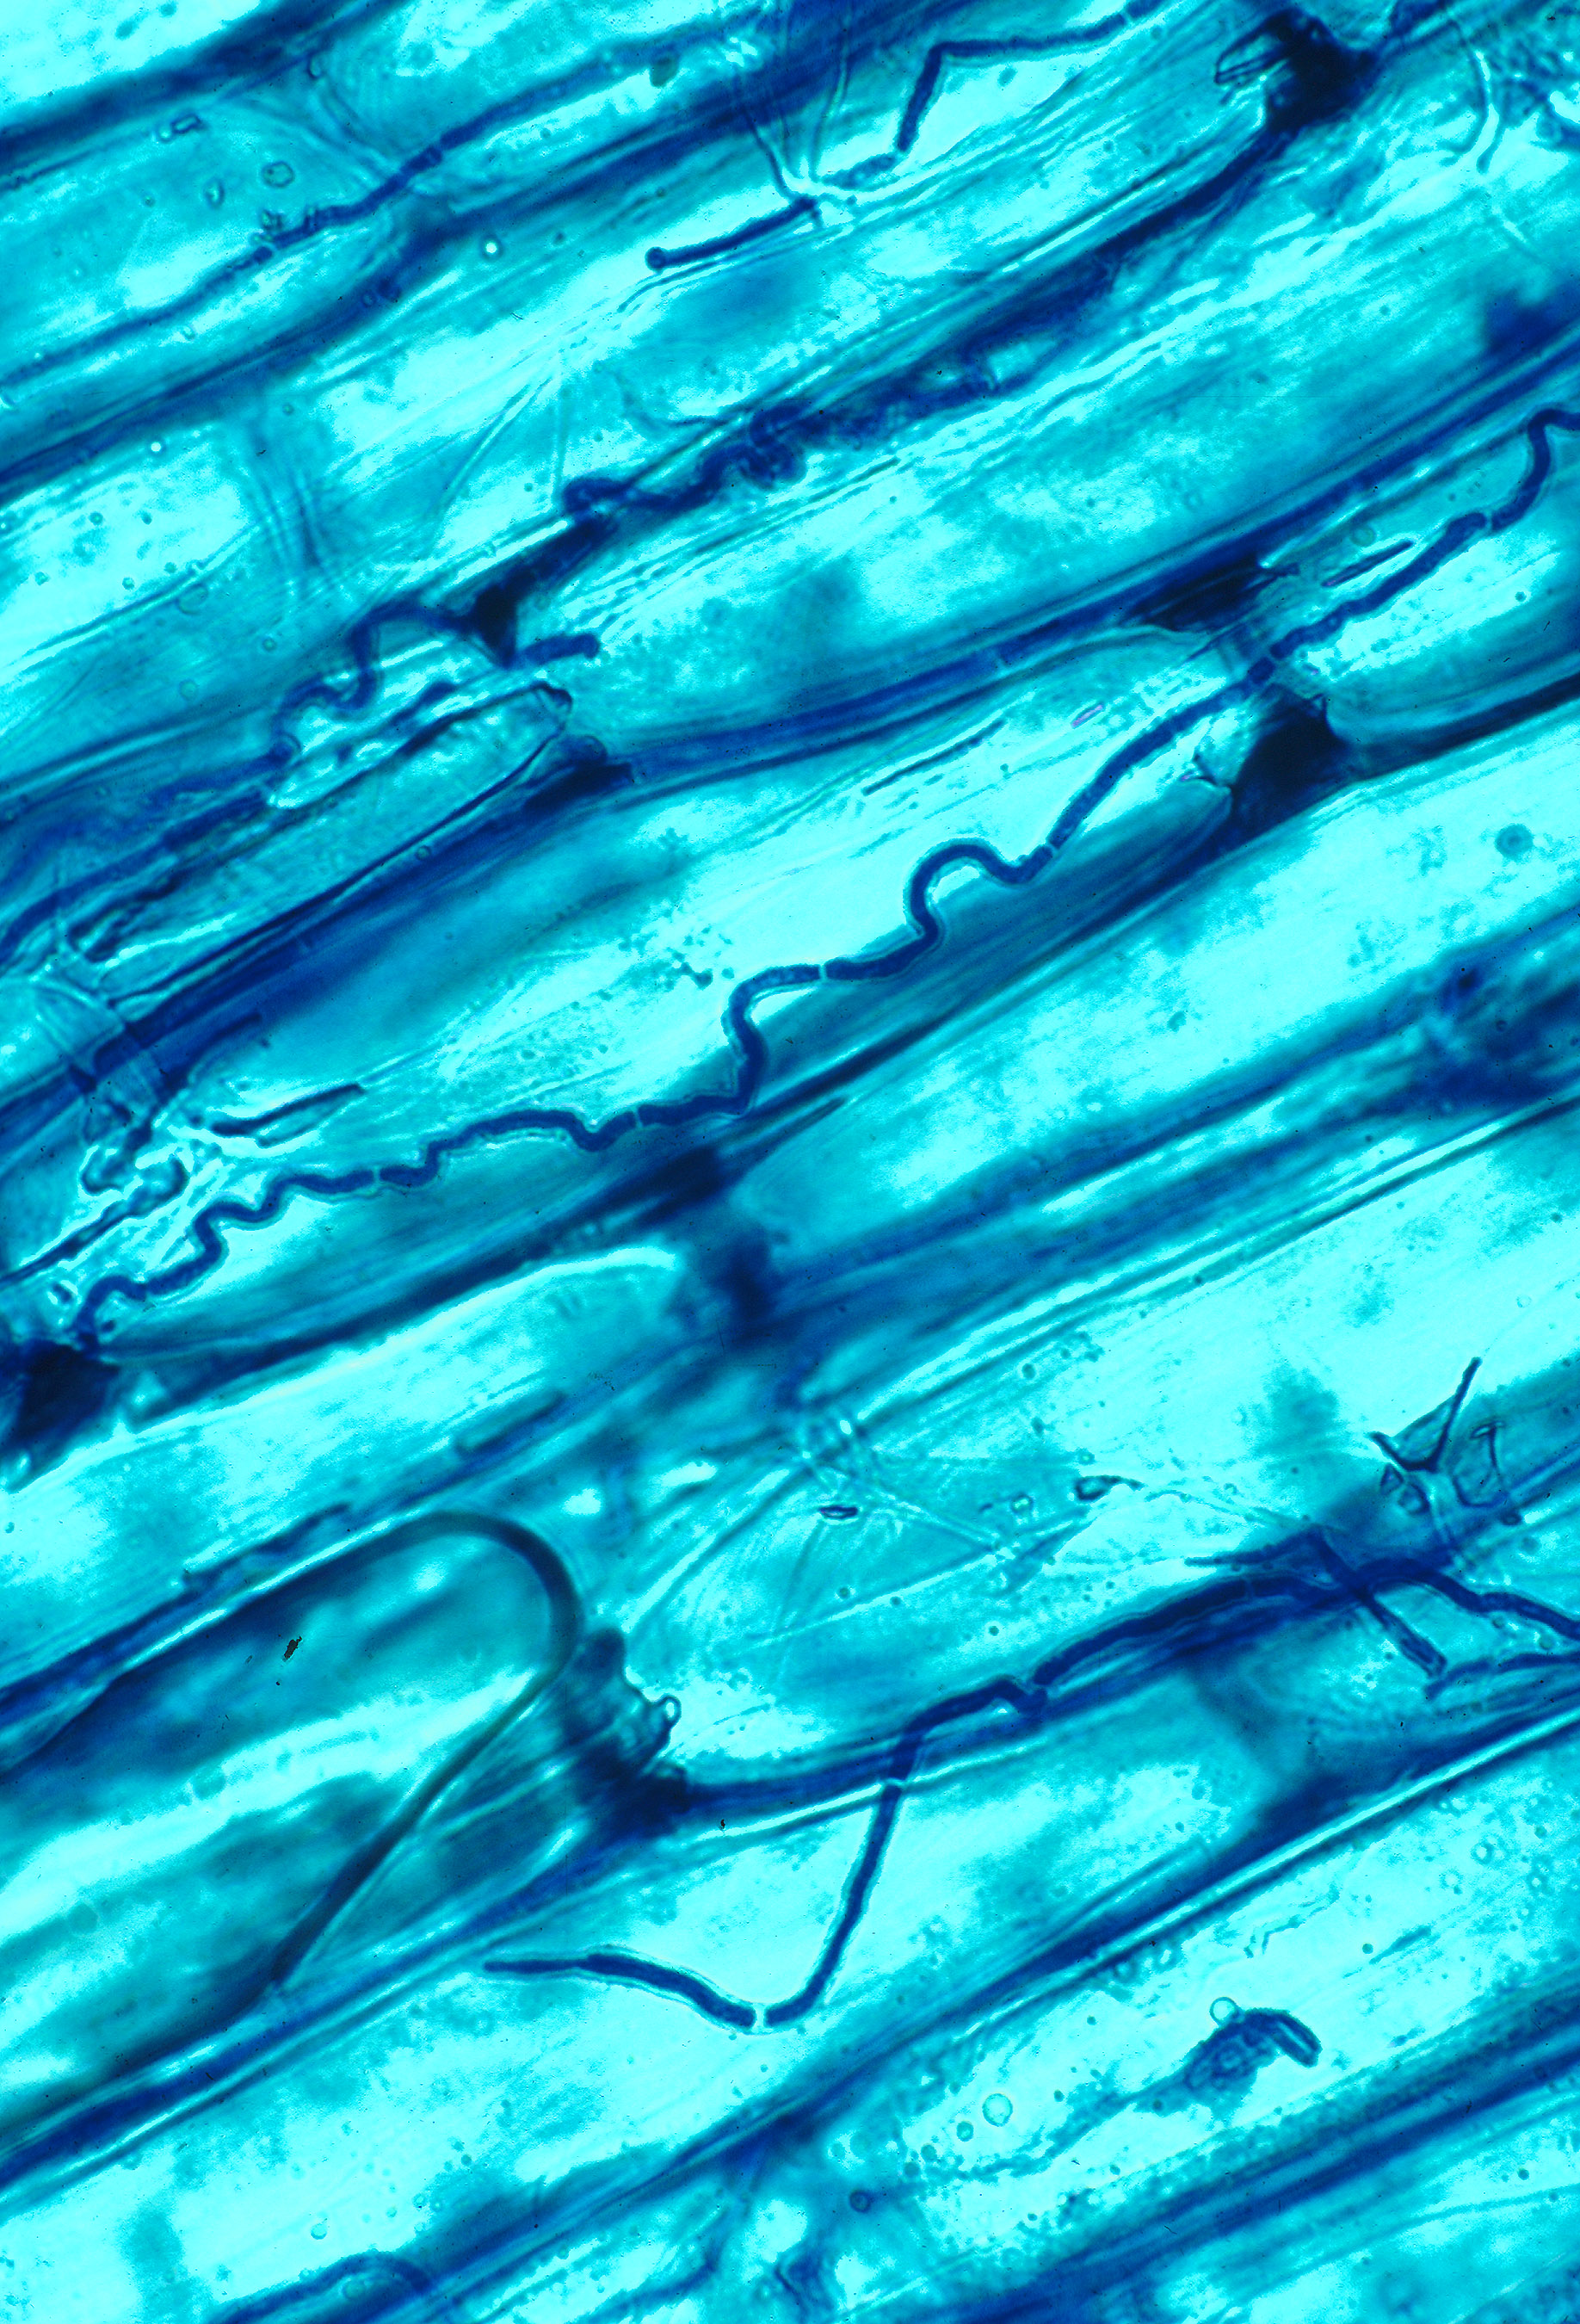
System
Endophytes – probably present in all land plants; function uncertain
Present in healthy tissue
Implicated in host defense, nutrient acquisition, generation of novel metabolites
Substantial interest in plant-microbe interactions and how they may drive ecological communities
Using Heuchera – edaphically and environmentally diverse, phylogeny is well understood, opportunity for population-level sampling

Slide 4
Questions
What are the major determinants of leaf endophyte diversity?
What are the major determinants of leaf endophyte community membership?

Slide 5
Potential drivers
Geography – latitudinal gradients or isolation-by-distance
Latitudinal gradients would reflect climate
Phylogeny/host species ID
Vertical transmission or species-specific traits such as tissue quality
Soil and climate
Demonstrated repeatedly for rhizosphere + root endophytes
Leaves may be more isolated from the soil environment

Slide 6
Predictors
Soil and climate/topography
Used online global datasets to associate environmental factors to plant occurrences
Soil (pH, sand %, carbon content)
Elevation
Mean annual temperature, aridity, annual precipitation
Host species identity
Plant host phylogeny
Patristic distance matrix
Different from host ID – could be plant traits or vertical transmission
Geography
Latitude or distance, depending on analysis

Slide 7
Molecular methods
Bacteria + fungi characterized (most studies do one)
Bacteria – V4 hypervariable region of 16S (small ribosomal subunit gene)
Fungi – ITS1 region of transcribed spacer between ribosomal subunit genes)
Sequenced via MiSeq – 250 bp forward and reverse reads
QIIME package used to analyze data
Includes sequence error correction, taxonomic classification, and community diversity stats

Slide 8
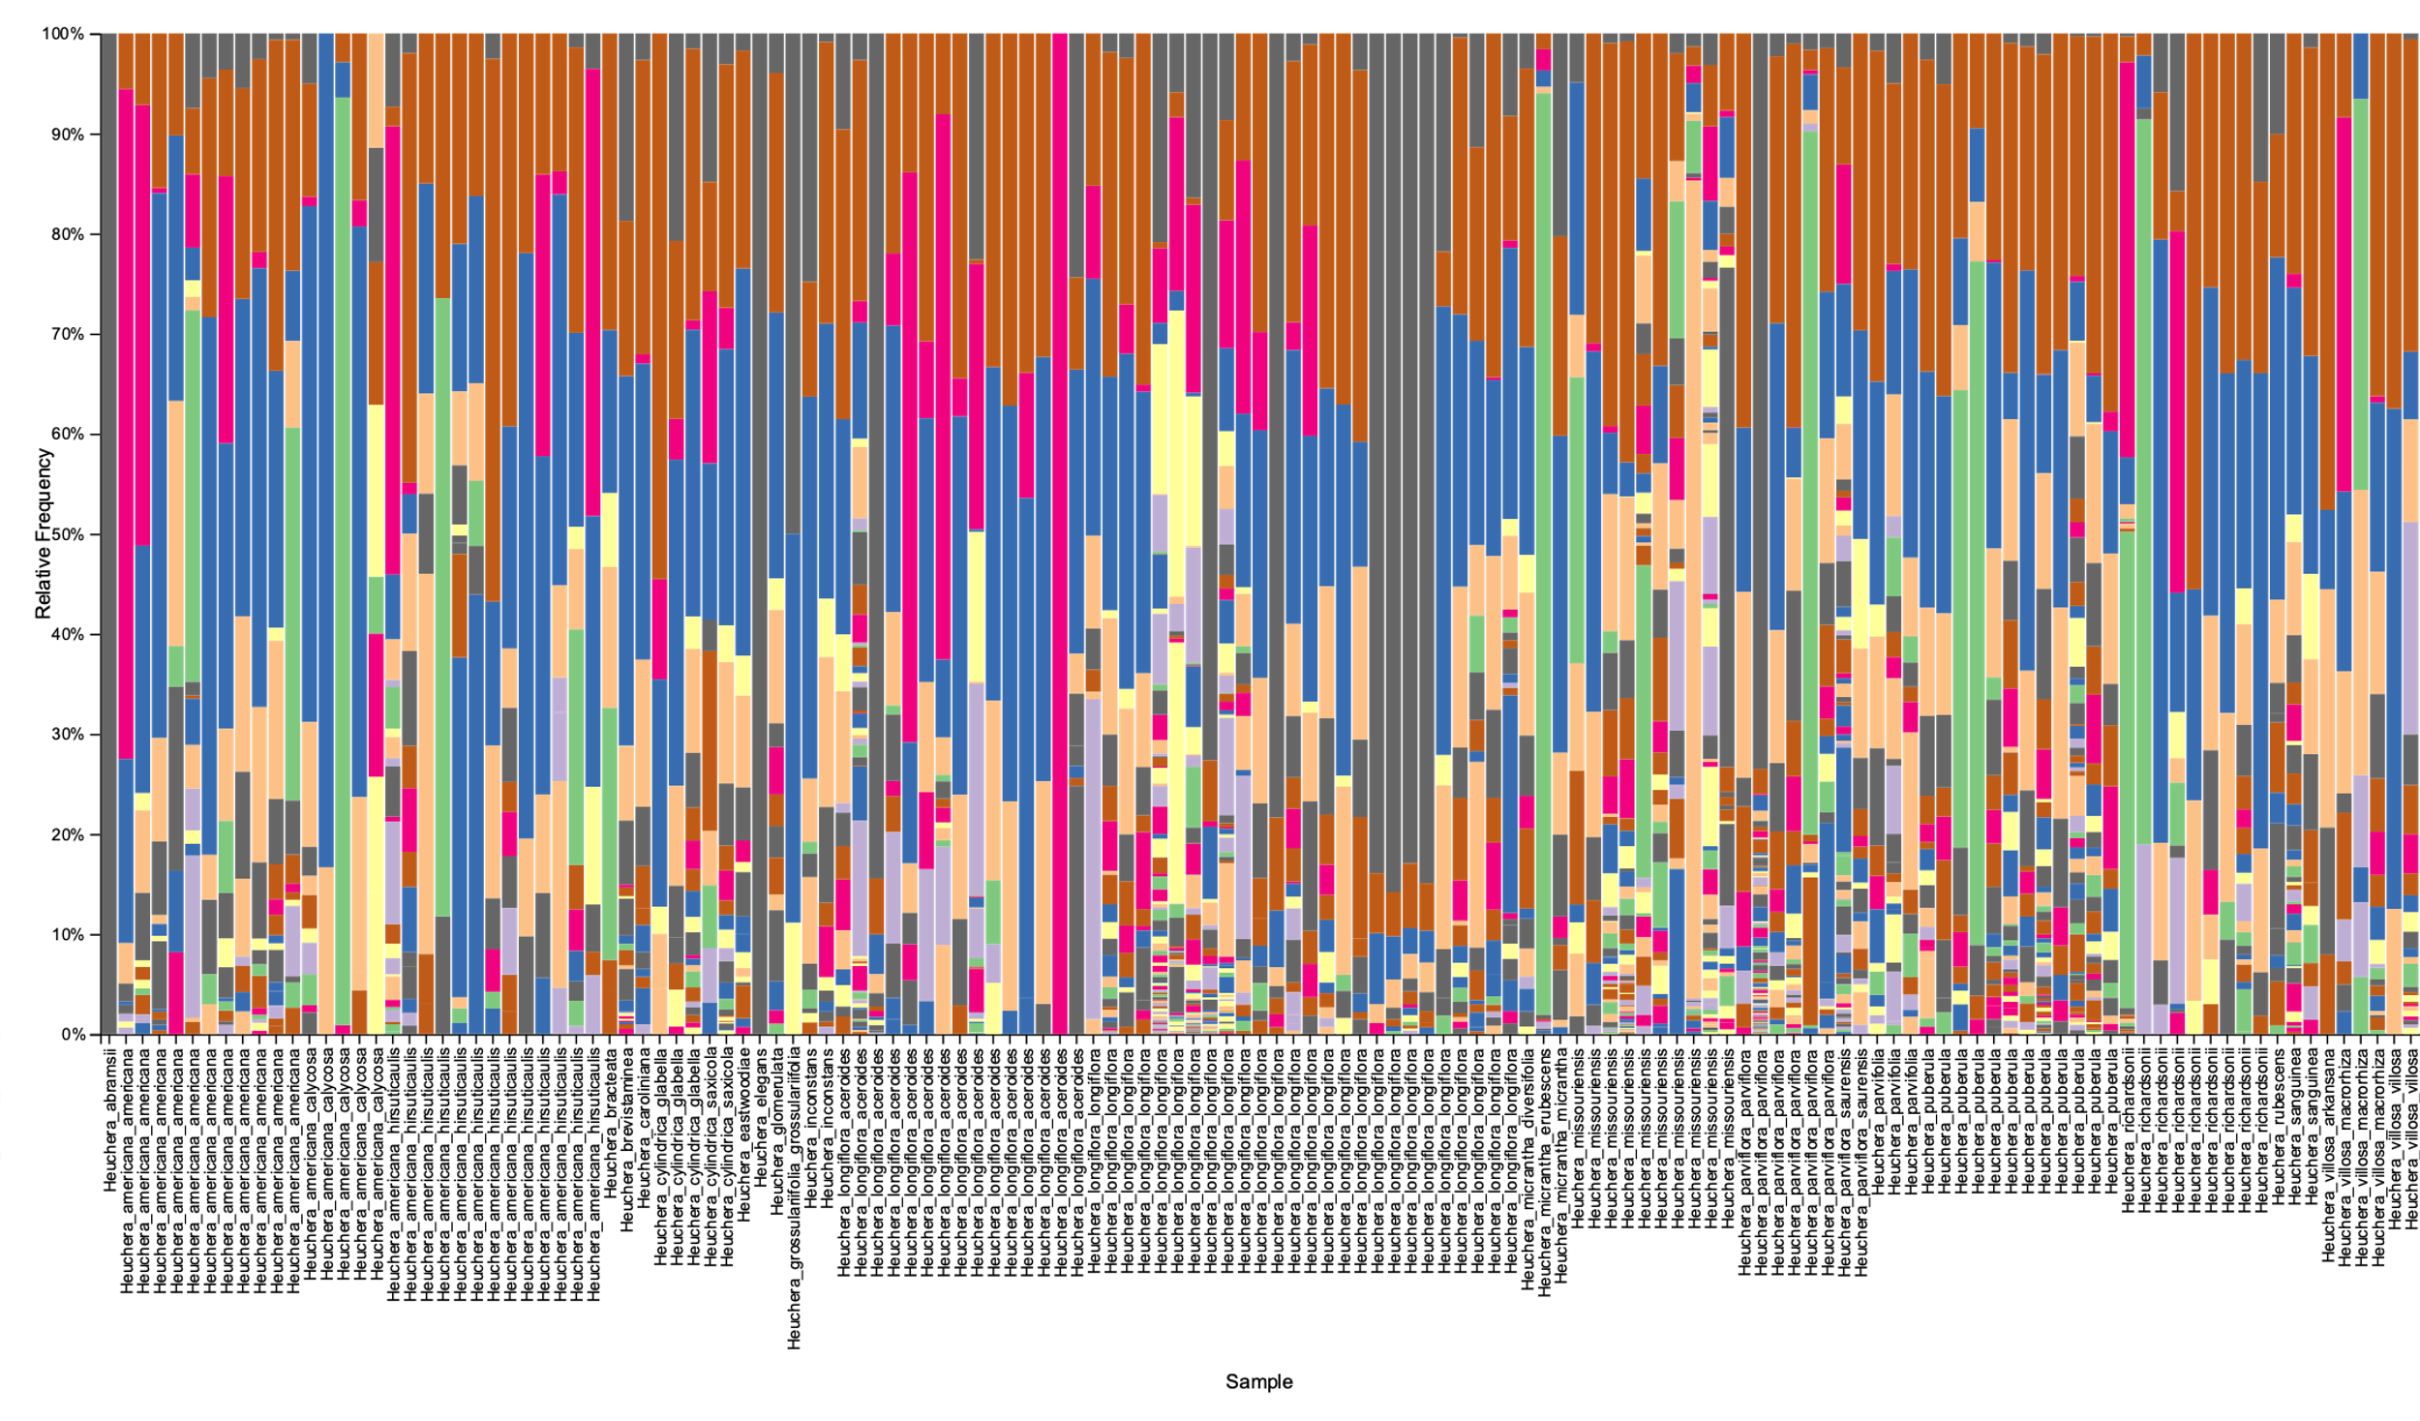

16S bacterial community taxa

Slide 9
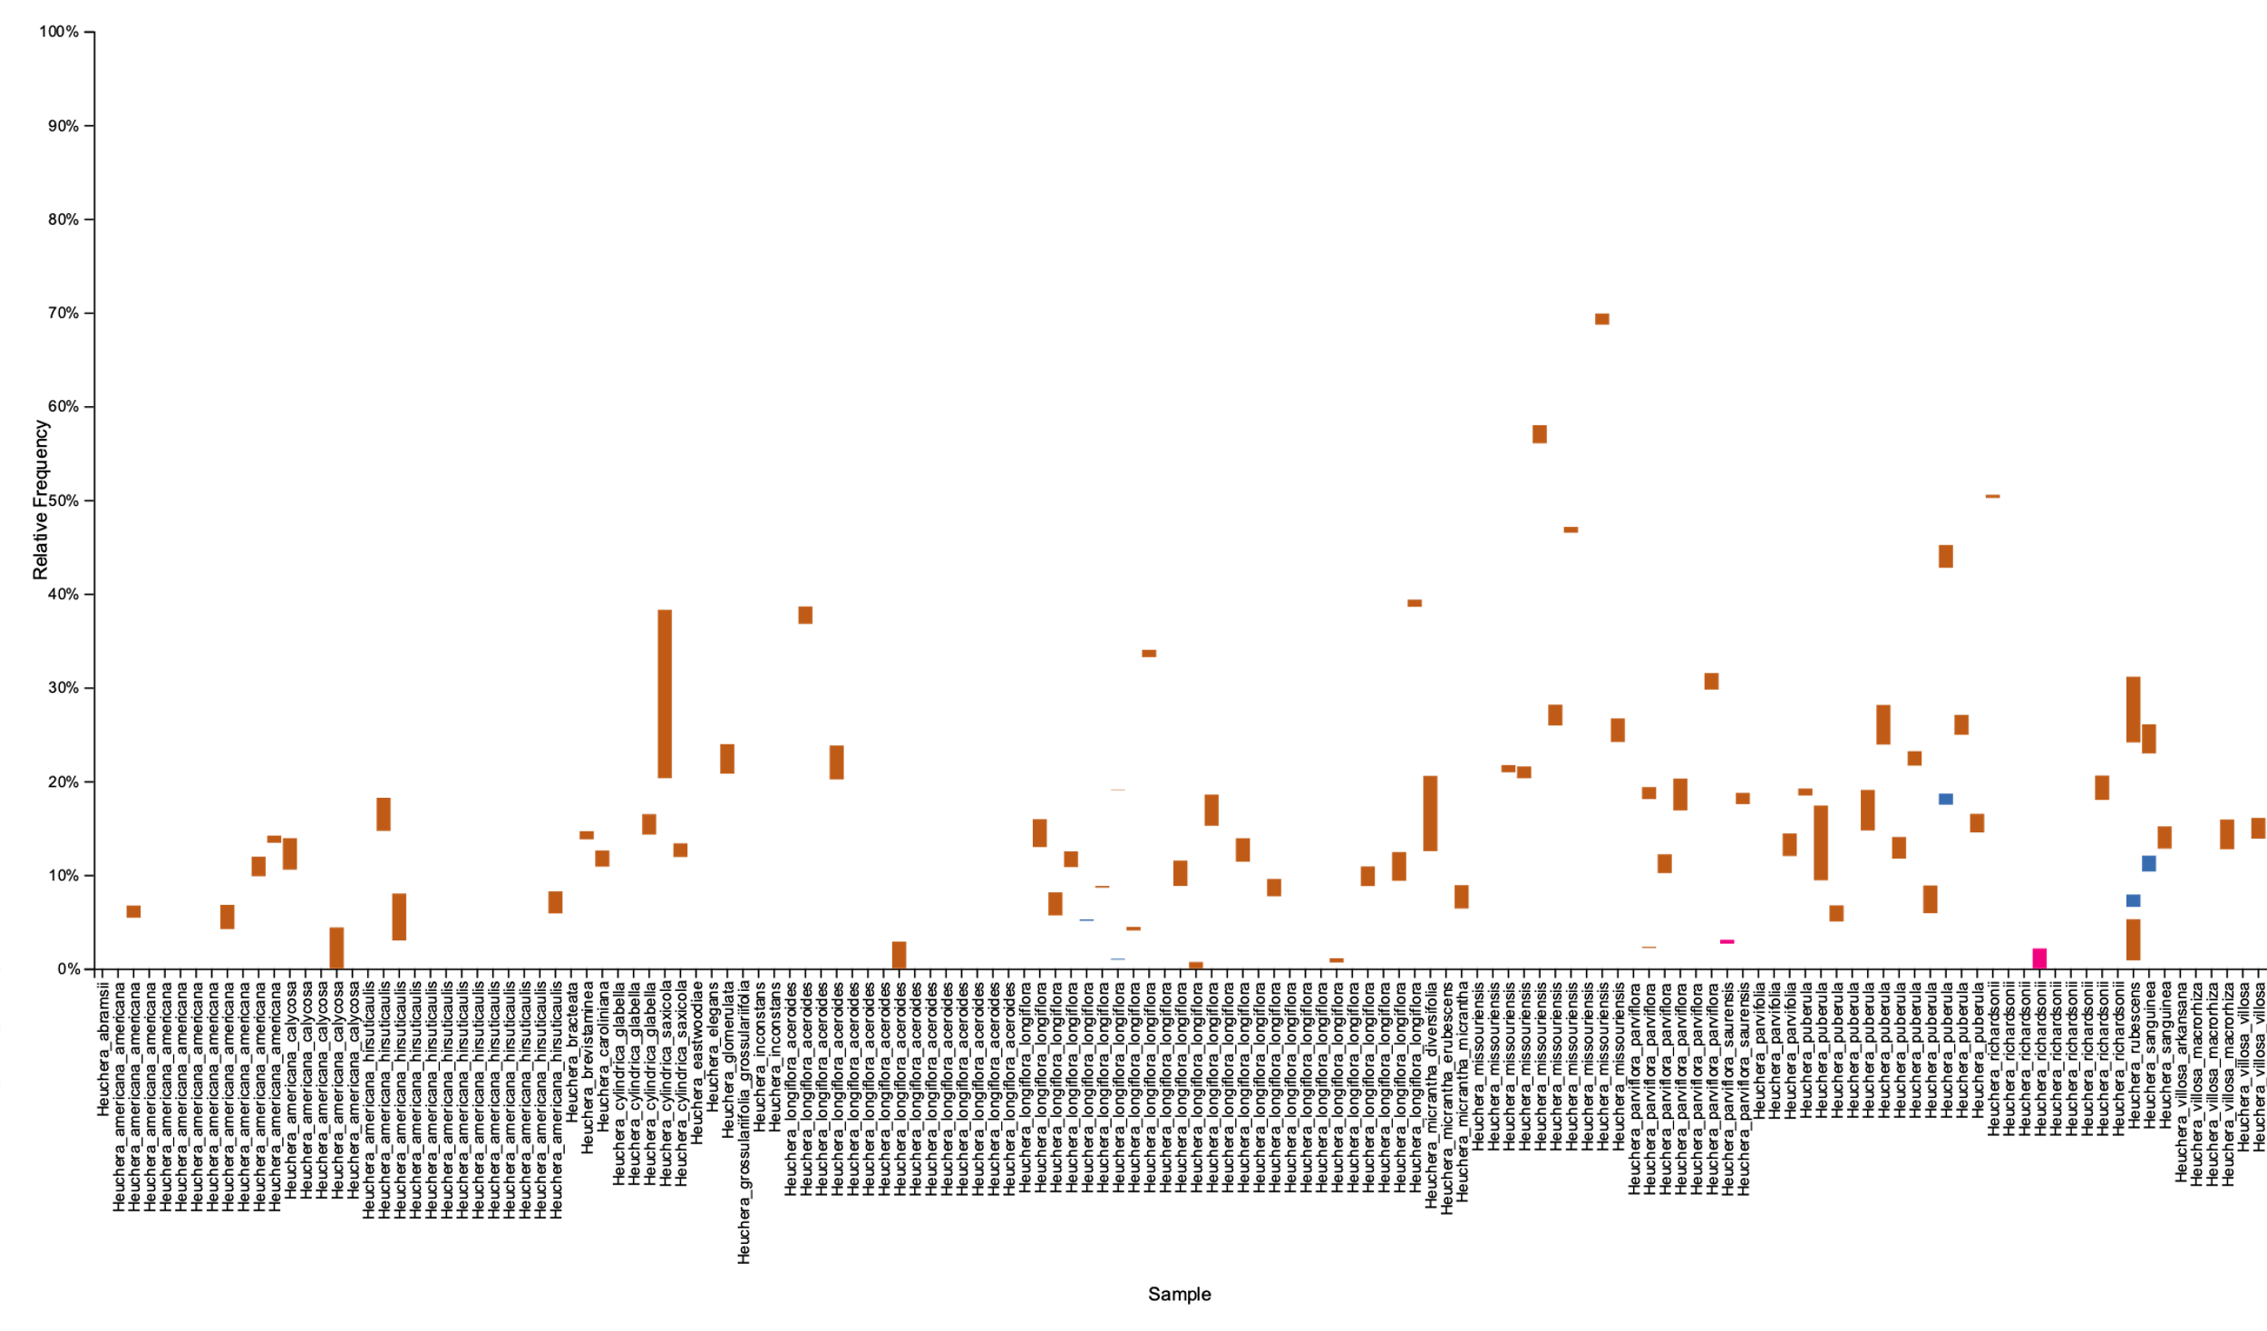
Rhizobial and actinorhizal taxa

Slide 10
Question: Determinants of diversity
Two metrics
Shannon diversity – species richness + abundance
Faith’s PD – phylogenetic diversity
Used three species groups with strong species sampling – Heuchera parviflora, americana, longiflora groups

Slide 12
Question: Determinants of diversity
Only one species group had an apparent trend
Parviflora – not significant (ANOVA)
Used a mixed model framework, used an ML approach to test for predictor significance
Null model favored – no predictors were significant

Slide 13
Question: Determinants of community composition
Used the UniFrac distance
A community distance, includes both presence/absence and phylogenetic distance
Different results for bacteria and fungi
Bacteria – plant phylogeny was significant (Mantel p = 0.003) but not geography
Fungi – plant phylogeny not significant, but host species, geography, and the environmental predictors were significant
Environment and geography likely confounded
Used partial Mantel test to control for geography, removes significance for environmental data

Slide 14
Interpretation
Microbial endophyte diversity similar across environmental gradients and hosts
Contrasts with rhizosphere literature – becoming a leaf endophyte may release microbes from these pressures
Microbial community memberships had different drivers for bacteria and fungi
Bacteria – a phylogenetic driver could represent vertical transmission or species traits, but species itself was not a significant predictor
Fungi – geography and species were the only significant predictor – suggests isolation-by-distance
While we don’t have the outside microbial community, if there were indirect environmental drivers for fungi we should be able to detect them

Slide 15
Summary
Microbial leaf endophyte community patterns different for bacteria and fungi
Diversity was similar across hosts and environments
Phylogeny, host species, and geography are independent drivers of different microbial communities
Most studies examining environmental drivers of microbe diversity do not control for geography

